Slide 1
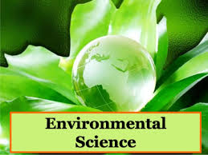
B.Tech Sem: 4
Batch: II
Dr. T. Maiyalagan

Slide 2

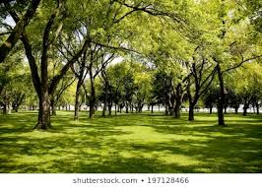

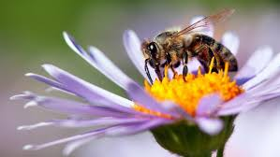
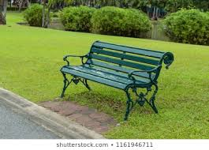

What is Environment?
Our surroundings

Slide 3

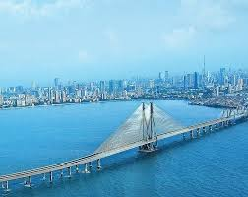
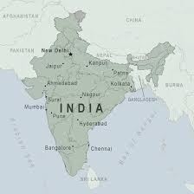
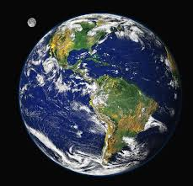
What is Environment?

Slide 4
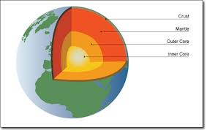
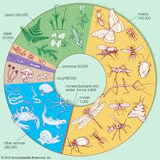

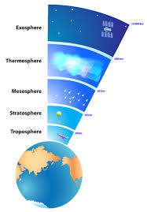
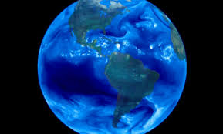
What is Environment?
Lithosphere
Biosphere
Atmosphere
Hydrosphere

Slide 5
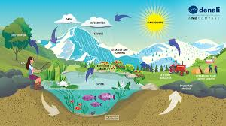
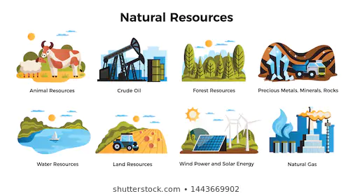
Why should we study EVS?
How we interact with the environment.
How do we upset the natural balance?
How do we use resources?
How do we produce waste?
What do we do with the waste?
What will be the consequences?
Ecosystem

Slide 6
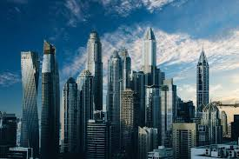
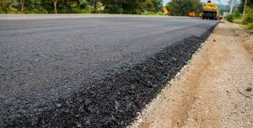
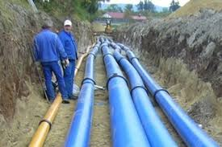
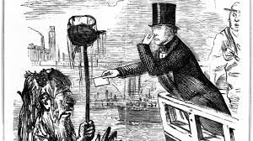
Why civil engineers shall study EVS?
Great Job
The Great Stink” of 1858

Slide 7
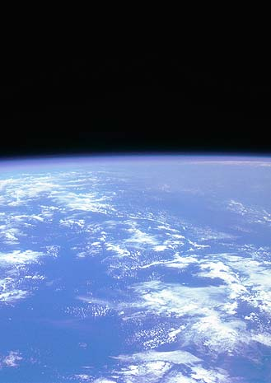
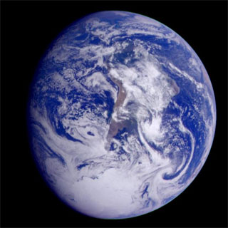
Introduction to the Structure and Composition of Earths Atmosphere

Slide 8
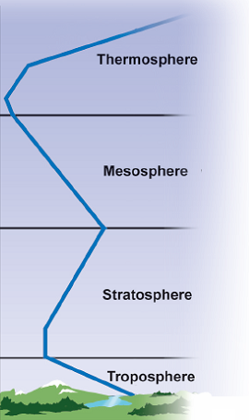
Layers of Atmosphere
The atmosphere has four layers
Thermosphere
Mesosphere
Stratosphere
Troposphere
600 km
80 km
50 km
10 km

Slide 9

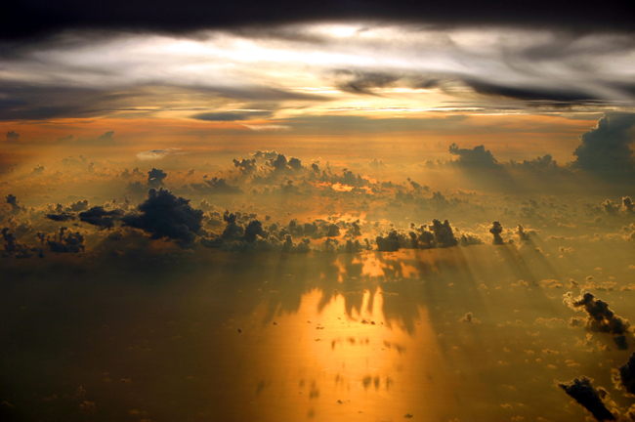
Layers of Atmosphere
Troposphere
Lowest and thinnest layer
16 km at equator, 8 km at poles
90% of the atmosphere’s mass
Temperature decreases with altitude
6°C per kilometer
Top of troposphere averages –50°C
Where weather occurs
Boundary between the troposphere, and the stratosphere is called the tropopause
View of troposphere layer from an airplane's window.

Slide 10
Layers of Atmosphere
Stratosphere
Extends from 10 km to 50 km above the ground
Less dense (less water vapor)
Temperature increases with altitude
Almost no weather occurrence
Contains high level of ozone
Ozone layer absorbs UV radiation
Upper boundary is called stratopause.

Slide 11
Layers of Atmosphere
Mesosphere
Extends to almost 80 km high
Gases are less dense.
Upper boundary is called mesopause, this is the
boundary between the mesosphere and the
thermosphere atmospheric regions.
Temperature decreases as altitude increases.
Coldest layer of Atmosphere
Gases in this layer absorb very little UV radiation.

Slide 12
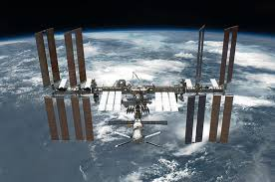
Layers of Atmosphere
Thermosphere
Above the mesosphere and extends to almost 600 km high
Temperature increases with altitude
Readily absorbs solar radiation which breaks the gaseous molecules and produces ions. Constitutes part of the ionosphere.
Temperature can go as high as 1,500 °C
Reflects radio waves

Slide 13
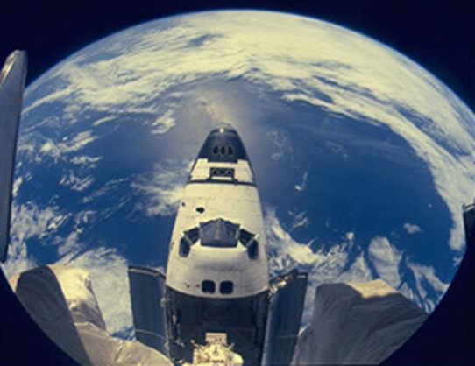
EXOSPHERE
The exosphere is the outermost layer of Earth’s atmosphere but there is no exact dividing line between this layer and space.
The exosphere begins at about 600 kilometers above Earth and does not have a specific outer limit.
Communication on Earth depends on satellites.
Satellites orbit Earth in the exosphere.

Slide 14


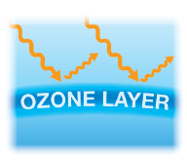
Layers of the Atmosphere
The four layers of the atmosphere include:
the troposphere, where we live;
the stratosphere, which contains the ozone layer;
the mesosphere, where meteors burn; and coldest layer
4. The thermosphere, where space station orbit Earth. Temperature is very high

Slide 15
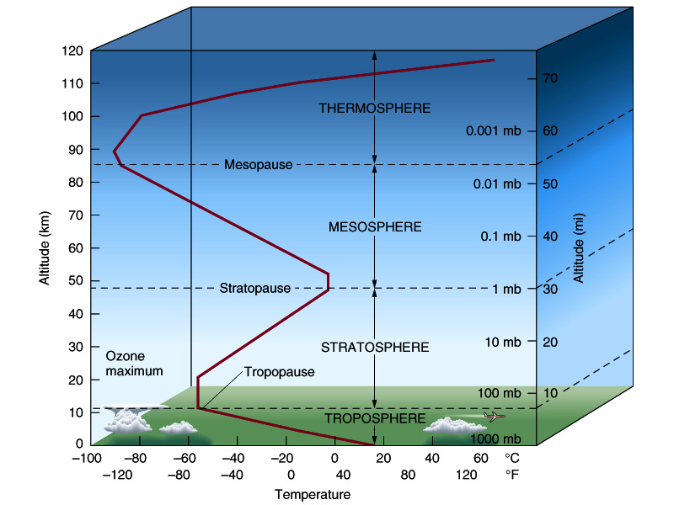
Height, Pressure and Temperature

Slide 16
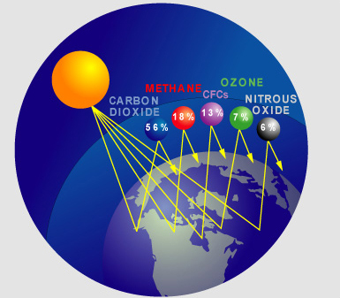
COMPOSITION OF ATMOSPHERE

Slide 17
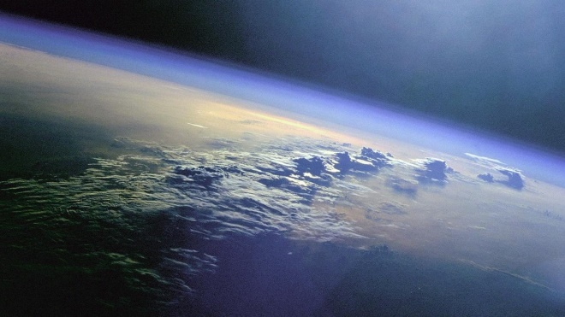
Earth’s Atmosphereere
Earth’s atmosphere is a layer of gases surrounding the planet.
The Earth is surrounded by a blanket of air, which we call the atmosphere. It reaches over 560 kilometers from the surface of the Earth.
Atmosphere:
Absorbs the energy from the Sun.
Recycles water and other chemicals.
Protects us from high-energy radiation and the frigid vacuum of space.
The atmosphere protects and supports life.

Slide 18
CRAZY FACT
-The total mass of the atmosphere is equivalent to 5.65 billion million tons.

Slide 19
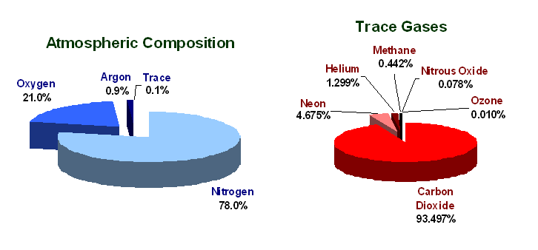
Composition of the Atmosphere
The atmosphere is comprised of a variety of gases:
Major Constituents (99%):
Nitrogen (N₂): 78%
Oxygen (O₂): 21%
Trace Constituents:
Argon (Ar), about 0.9%
Water vapor (H₂O), up to 10000 ppmv
Carbon dioxide (CO₂), 350 ppmv
Ozone (O₃), near zero at the surface,
up to 10 ppmv in the stratosphere
Methane (CH₄), 1.7 ppmv
and others…..
ppmv = “parts per million by volume”

Slide 20
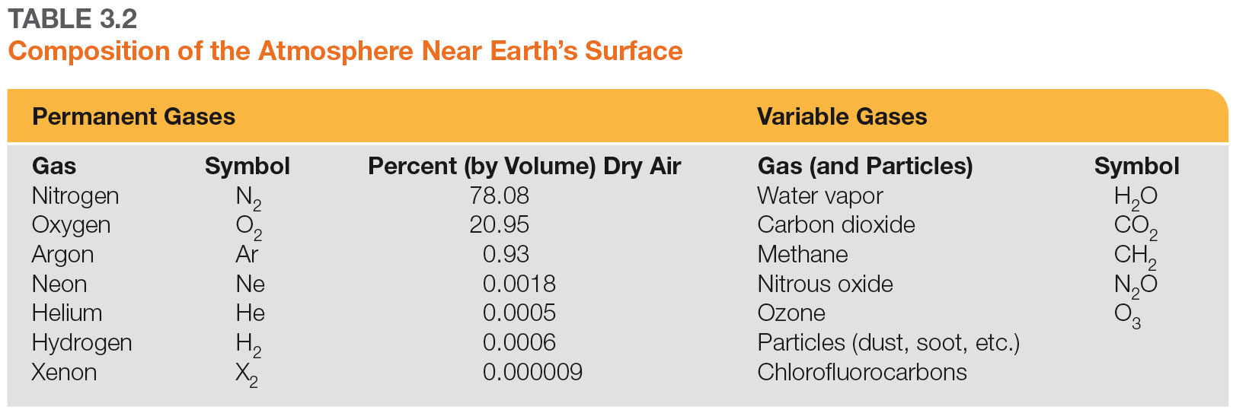
Composition of the Atmosphere

Slide 21
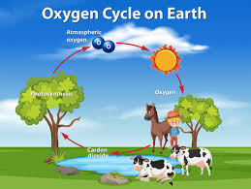
Composition of the Atmosphere
What about Nitrogen?
Proteins: important for survival
Human and plant can not use nitrogen directly. We need support from bacteria. This process called nitrogen fixation.

Slide 22
Composition of the Atmosphere
Industrial Production
Catalyst,
high T
N₂ + 3H₂
2NH₃
Not sufficient for modern cultivation requirement

Slide 23
Gases Making Up Atmosphere
Permanent Gases-Those gases whose relative abundance is constant within the homosphere (homogeneous mixture). Ex. O₂, N₂, CO₂ etc..
Variable Gases-Gases present in amounts that vary greatly in abundance, either vertically, horizontal, or seasonal. Water vapor is the most important variable gas.

Slide 24
Relevant Terms
Homosphere-The lowest 80km of the atmosphere, which the relative abundance of the permanent gases is constant.
Heterosphere- At high altitude where gases are not well mixed but rather are stratified according to weight. Where lighter weighing gases are found.

Slide 25
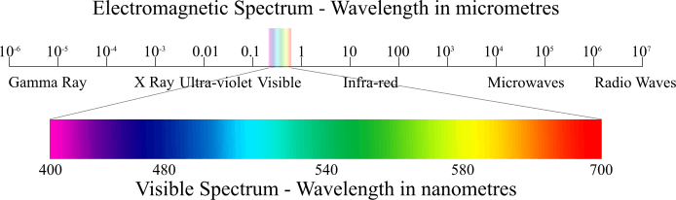
Molecule with three or more atoms exhibit highly complex electromagnetic absorption and emission spectra.
This complexity includes a variety of energetic radiation with different frequencies as these molecules absorb and emit radiation called- “Spectral band”
Temporal and spatial viability is added to this spectral complexity.

Slide 26
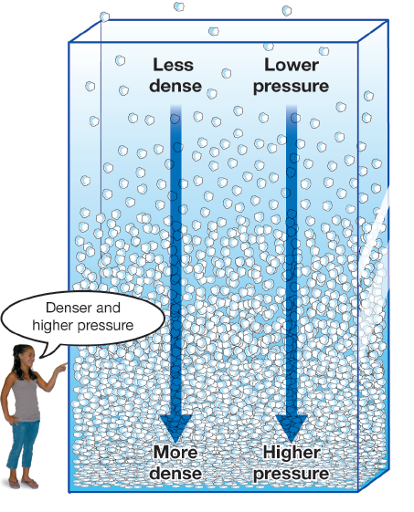
Pressure in the atmosphere
Atmospheric pressure is the force per unit area exerted into a surface by the weight of air above that surface in the atmosphere of Earth.
The gas molecules closest to Earth’s surface are packed together very closely.
This means pressure is lower the higher up you go into the atmosphere.

Slide 27
Pressure in the atmosphere
At sea level, the weight of the column of air above a person is about 9,800 Newtons (2,200 pounds)!
This is equal to the weight of a small car.

Slide 28
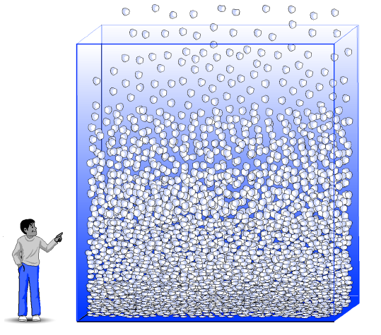
Pressure changes with altitude
Pressure varies smoothly from the Earth's surface to the top of the mesosphere.

Slide 29
ENVIRONMENTAL POLLUTION

Slide 30
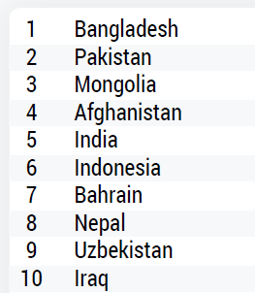
World country/region ranking

Slide 31
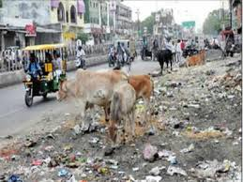
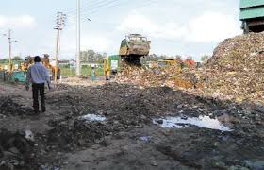
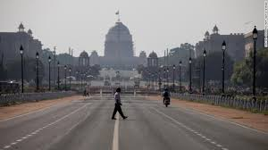
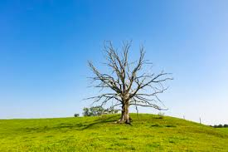
10 Most Polluted Cities in the World
Ghaziabad, India
Lahore, Pakistan
Delhi, India
Lucknow, India
Muzaffarnagar, India
Dhaka, Bangladesh
Antakya, Turkey
Hapur, India
Peshawar, Pakistan
Kampala, Uganda

Slide 32
POLLUTION
Any act that
1. Contaminate the environment
2. Alters the surroundings unwantedly
3. Decreases the quality of air, water and soil
4. Affects the health of human, animals and plants
POLLUTANTS
The material which causes Pollution

Slide 33
CAUSES FOR POLLUTION
1. Tremendous uncontrolled growth of
human populations.
2. Rapid industrialization
3. Rapid urbanization
4. Deforestation
5. Radio activities

Slide 34
Types of pollutants
Biodegradable pollutants
Non- Biodegradable pollutants
1.Biodegradable pollutants
They decompose rapidly by the natural process into simpler, harmless, substances in due course of time (by the action of micro-organisms like certain bacteria) Like, Domestic wastes (garbage), urine, sewage, agriculture residues, paper, wood
2. Non- Biodegradable pollutants
They do not decompose rapidly by the natural process into simpler, harmless substances in nature. Like plastics, polythene bags, insecticides, pesticides, mercury, lead, arsenic.

Slide 35
Classification of Pollution
Air pollution
Water pollution
Soil pollution
Marine pollution
Noise pollution
Thermal pollution
Nuclear hazards

Slide 36
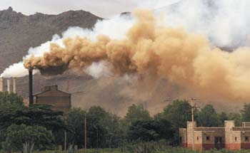
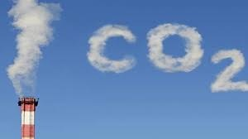
Air pollution
Contamination of atmospheric air by gases, dust, smoke and wastes.
Injurious to living organism.
Most of the air pollutant present in the troposphere
Every person breathes approximately 22000 times /day and inhaling 15-22 Kg of air daily.
Polluted air causes Physical ill effects, besides undesirable aesthetic and physiological effect.

Slide 37
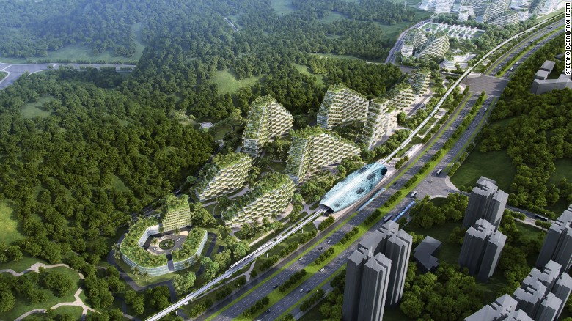
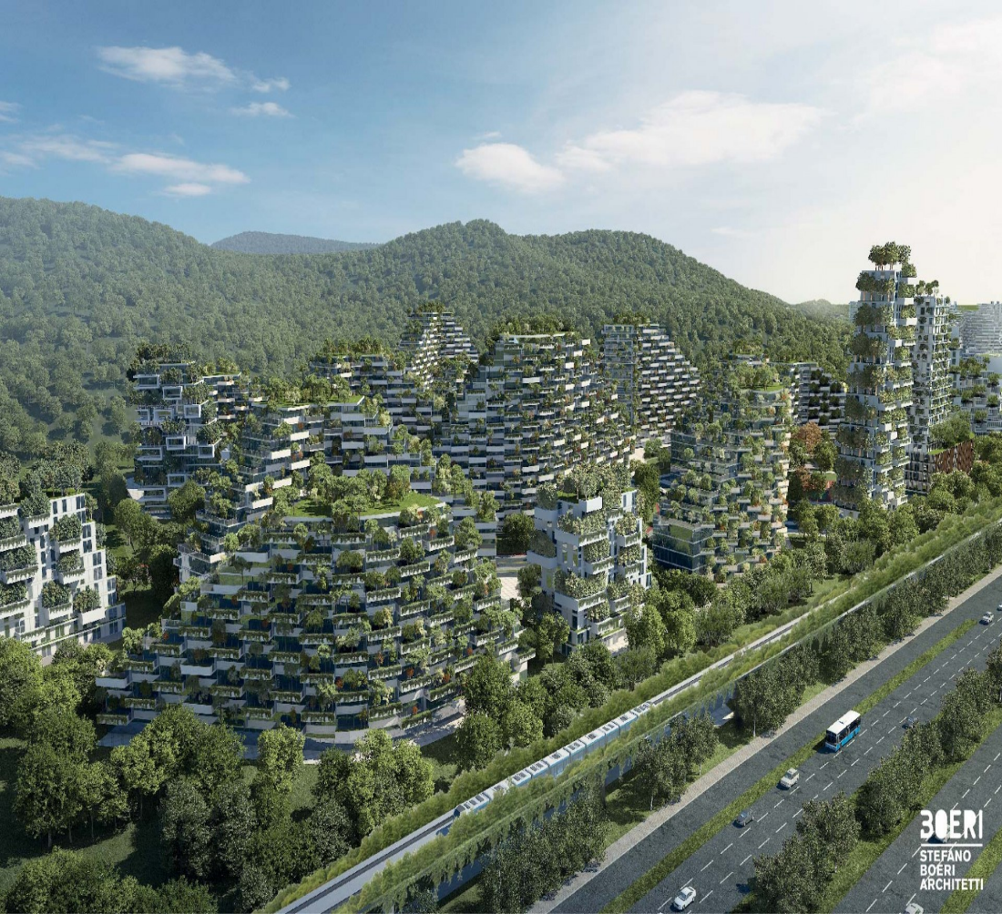
Liuzhou Forest City, with one million plants and 40,000 trees
It is hoped that the extra plant-life will absorb almost 10,000 tonnes of CO_{2,} produce 900 tonnes of oxygen and 57 tonnes of pollutants annually

Slide 38
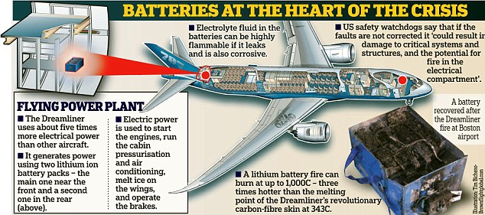
Main issue - batteries
■ Price of stacks, cycle life
■ Driving range
■ Charging speed

Slide 39
Sources of air pollution
1. Natural sources
2. Man made activities
1. Natural sources
Examples
a) Volcanic eruption
b) Forest fires
c) Biological decay
d) Radioactive materials

Slide 40
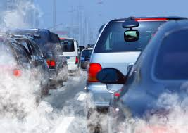
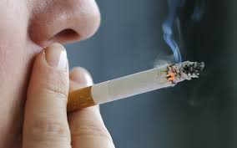
2. Man-made activities
a) Thermal power plants
b) Vehicular emission
c) Fossil fuel burning
d) Agricultural activities
e) Smoking

Slide 41
Classification of air pollutants
i) Primary pollutants
ii) Secondary pollutants
Usually, primary pollutants are substances directly emitted from a process,
Examples: ash from a volcanic eruption, the carbon monoxide gas from a motor vehicle exhaust or sulfur dioxide released from factories.
Secondary pollutants are not emitted directly. Rather, they form in the air when primary pollutants react or interact.
Examples: Ground level ozone is a prominent example of a secondary pollutant.

Slide 42
ii ) Secondary pollutants
Examples
Ozone: forms when hydrocarbons (HC) and nitrogen oxides (NOx) combine in the presence of sunlight
NO₂: which is formed as NO combines with oxygen in the air
Acid rain: produces when sulfur dioxide or nitrogen oxides react with water.

Slide 43
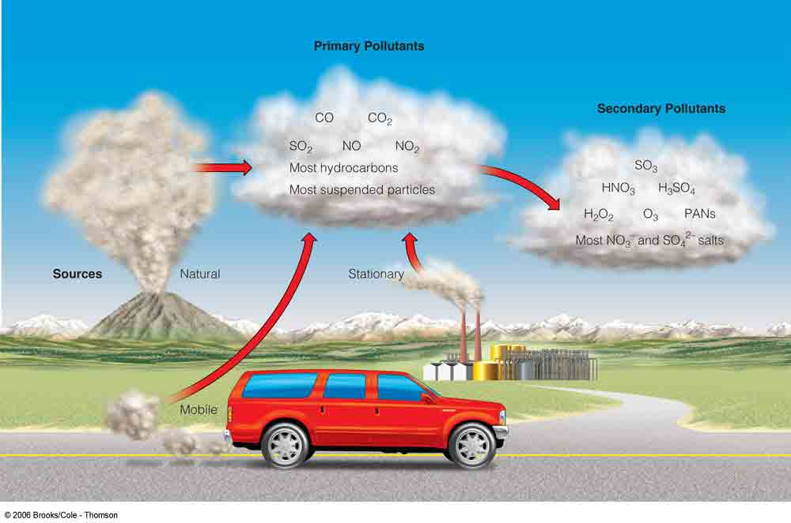

Slide 44
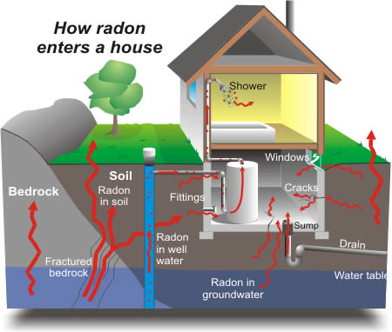

INDOOR AIR POLLUTANTS:
Sources(causes):
Radon gas: emitted from the building material like bricks, concretes, tiles etc.,
Burning of fuels in the kitchen, cigarette smoke liberates the pollutants like CO , SO_{2 .}

Slide 45
Air Pollutants may exist in two major forms namely gases and particulates
1. Gases: SO₂, SO₃, CO, CO₂, NOx, H₂S, O₃ casus pollution
2. Particulates: Dust, Smoke, Smog, Asbestos, Lead dust, Polynuclear aromatic hydrocarbon

Slide 46
Common air pollutants
Sources and their effects
Carbon monoxide (CO)
Properties: Color less , Odorless and toxic gas
Affects: Injurious to human and animal health
Sources: About 77% comes from motor vehicles
(mainly petrol engine vehicles)
Cigarette smoking
Industrial source, Automobile exhaust gases

Slide 47
Human sources
Incomplete combustion of fossil fuel
Power plants
Human health effects
CO binds with hemoglobin (RBC) to form carboxy hemoglobin, thereby hampering the transfer of oxygen to the tissues.
Headache, anemia
At high levels it leads to coma and death
Environmental effects
It increases global temperature

Slide 48
Sulphur dioxide(SO₂)
Colorless and irritating gas
Formed from burning of coal and oil.
It is converted in to sulphurous acid in acid rain process.
Human sources
Power plants 88%
Industrial process 10%
Health effects
Breathing problems even for healthy people
Eye irritation, Throat problem,
cardiac diseases to human,
Environmental effects
Damage to agriculture, Chlorophyll destruction
Sulphurous acid in acid rain damage trees, plants, soil and aquatic life.

Slide 49
Carbon dioxide (CO₂)
Colorless and odourless green house gas
Formed from Combustion of fossil fuel, woods, etc.
Cement production.
Human sources
Respiration process
Power plants
Health effects
Respiratory disorders and suffocations
Environmental effects
Increasing the temperature of climate
Each degree Celsius rise in temperature caused due to carbon dioxide levels could cause about 1,000 deaths. The gas boosts concentrations of surface ozone, particles and carcinogens, all of which are harmful to human health.

Slide 50
Ozone (O₃)
i) Highly reactive
ii) Irritating gas
iii) Unpleasant odour
iv) It forms in the troposphere
v) It is a major component in the smog.
Human sources
Nitrogen oxides
Volatile organic compounds (VOC)
Health & Environmental effect
skin cancer in animals and human
Casus lung infection
Destruction of life in earth
Moderates the climate

Slide 51
Sulphur trioxide(SO₃)
Oxidation of SO₂ in the atmosphere under the influence of sunlight.
Even 1 ppm of SO₃ in the air causes breathing trouble and irritation to the respiratory tract
Hydrogen sulphide (H₂S)
H₂S enter the atmosphere as the pollutant through decomposition of sewage wastes or organic matter from various industries
It is poisonous, it blackens the lead paints and causes corrosion of metals.

Slide 52
Nitrogen Oxides (N₂O, NO, NO₂)
Sources
Combustion of fuel
Acid manufacture
Explosive industry
Acid packing plants
High temperature combination of N₂ and O₂
Health & environmental effects
Human respiratory tract irritation
Damage to plants
Eye irritation
Reaction of hydrocarbon under sunlight form smog (produces O₃)
Formation of nitric acid causes acid rain problems

Slide 53
What is smog (Smoke + Fog)
It is also called as London smog. Smog which is normally happened in the morning hours during winter when the humidity is very high.
Smog is a kind of air pollution, commonly occurred in the industrial urban areas.
Analysis of the smog indicates mainly the presence of SO₂ along with the particulates. Sulphurdioxide oxidizes into sulphur trioxide in the atmosphere and forming acid aerosol.
Health effects
Breathing problems
Cough, Heart diseases
Eye, Nose and Throat irritation
Environmental effects
Ozone depletion
It reduces the visibility
It can damage plants and trees

Slide 54
PHOTOCHEMICAL SMOG
Photochemical smog is produced when pollutants from the combustion of fossil fuels react with sunlight. The energy in the sunlight converts the pollutants into other toxic chemicals. In order for photochemical smog to form, there must be other pollutants in the air, specifically nitrogen oxides and other volatile organic compounds (VOCs).
When nitrogen oxides and VOCs interact with sunlight, secondary pollutants are formed, such as ozone and peroxyacetyl nitrate (PAN). These secondary pollutants are what we have been calling photochemical smog. You might think, 'Hey, isn't ozone good for protecting our atmosphere?' Well, it is, but only at levels high above the surface. When ozone is near humans, it can cause serious problems with our lungs and vision. PAN is one of the chemicals that is responsible for damaging lung tissue.
This is a toxic mixture of NO₂, troposphere Ozone, volatile organic compounds and peroxy-acetyl nitrate (PAN)
All these chemicals are highly reactive and oxidizing substances. They are creating chemically reducing atmosphere
Due to incomplete oxidation of fossil fuel, automobile exhaust, the primary pollutants concentration,viz NO, VOC, Particulate matter begin to rise during traffic hours and produce secondary pollutants-such as ozone and nitrogen dioxide by photochemical reactions.

Slide 55
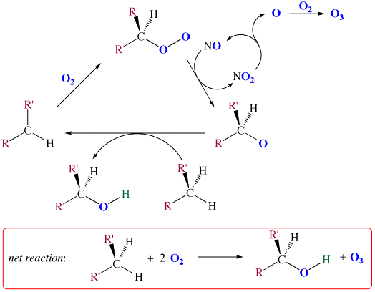
Photochemical Reactions
•
sun light
•
•
Hydrocarbons are attacked by ozone yielding partially oxidized hydrocarbons such as aldehydes, ketones, peroxides, peroxyacetyl nitrates (PAN) etc. These chemical compounds are capable of absorbing solar radiation and undergo photochemical reaction involving highly reactive free radicals such as OH free radicals resulting aerosol which is called photochemical smog.
•

Slide 56
Lead (Pb)
It is a solid, toxic metal
It can emit particulates
Human sources
Paint, smelters, storage batteries and leaded petrol.
Health effects
Damage brain and whole nervous system
Mental retardation
Digestive problems
Cancer in test animals
Environmental effects
Wild life destruction

Slide 57
ACID RAIN
Normal rain water is always slightly acidic in nature because of the fact that CO₂ present in the atmosphere gets dissolved in it and produces carbonic acid, H₂CO₃.
Because of the presence of SO_{x} and NO_{x} gases as pollutant in the atmosphere, the pH of the rain water is further lowered.
This type of precipitation of water is called ACID RAIN (or) ACID DEPOSITION

Slide 58
Formation and causes of Acid rain
Acid rain means the presence of excessive acids in rain water.
The thermal power plants, industries and vehicles release nitrogen oxides and sulphur oxides into atmosphere due to burning of coal and oil.
When these gases react with water vapour in the atmosphere, they form acids and descend on to the earths acid rain through rain water.
SO₃ + H₂O H₂SO₄
NO₂ + H₂O HNO₃

Slide 59
EFFECTS OF ACID RAIN
Increases the acidity of rain-water
Damages fresh water life.
In the form of mist it causes direct damage to plants.
Causes irritation to eyes and mucus membrane.
Accelerates the rate of corrosion of metals.
Causes damage of building block
Dissolves salt in soil like CaCO₃, MgCO₃ and metal, which passes into ponds lakes river and cause toxic effect to aquatic life

Slide 60
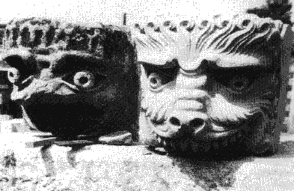
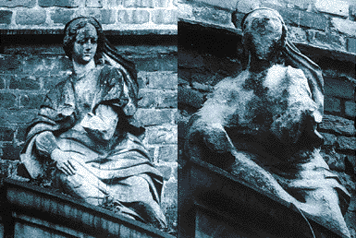
Effects of Acid Rain
Acidification of bodies of water
Damage of vegetation
Damage to building materials, statues, etc.

Slide 61

The ozone layer
In the 1970s, scientists noticed that the ozone layer in the stratosphere above Antarctica was thinning.

Slide 62

Chlorofluorocarbons & the ozone layer
A group of chemicals called chlorofluorocarbons (or CFCs) were once commonly used in air conditioners, in aerosol spray cans, and for cleaning machine parts.
In the London Agreement of 1991, more than 90 countries banned the production and use of CFCs except for limited medical uses.

Slide 63

Chlorofluorocarbons & the ozone layer
The ozone layer absorbs the Sun’s high-energy ultraviolet (UV) radiation and protects the Earth.

Slide 64


Slide 65
UV
O_{2(g)}
O_{(g)} + O_{(g)}
O_{2(g)} + O_{(g)}
O_{3(g)}
UV
˙
˙
CF₂Cl_{2(g)}
Cl_{(g)} + CF₂Cl_{(g)}
˙
˙
Cl_{(g)} + O_{3(g)}
ClO_{(g)} + O_{2(g)}
˙
˙
ClO_{(g)} + O_{(g)}
Cl_{(g)} + O_{2(g)}

Slide 66
GREENHOUSE EFFECT
The trapping of heat by gases in the atmosphere.
Naturally occurring greenhouse gases:
Water vapor
Carbon dioxide
Methane
Nitrous oxide
Ozone
Greenhouse gases that are not naturally occurring
Hydro fluorocarbons (HFCs)
Per fluorocarbons (PFCs)
Sulfur hexafluoride (SF₆)
Generated in a variety of industrial processes.

Slide 67

The Greenhouse Effect on Earth
Earth’s atmosphere is slightly warmer than what it should be due to direct solar heating because of a mild case of greenhouse effect…
The ground is heated by visible and (some) infrared light from the Sun.
The heated surface emits infrared light.
The majority of Earth’s atmosphere (N₂ and O₂) are not good greenhouse gas.
The small amount of greenhouse gases (H₂O, CO₂) traps (absorb and re-emit) the infrared radiation, increasing the temperature of the atmosphere…

Slide 68

Some Solar radiation redirected by both the Earth & atmosphere
Some of the infrared radiation passes through the atmosphere. some is observed and re-emitted in all directions by greenhouse gas molecules. This causes the earth surface and lower atmosphere to warm
SUN
Solar radiation Passes through the Earth’s atmosphere
Atmosphere
The majority of the radiation is absorbed by the Earth’s Surface with it warms
Infrared radiation is realized from the Earth Surface
EARTH

Slide 69




Greenhouse Effect
350
Atmospheric
CO₂ (ppm)
300
250
1000
1500
2000
Year
FACT: 15% increase in [CO₂] in last 100 years
Cause:
Change from agricultural to industrial lifestyle
Burning of fossil fuels (petroleum, coal)
Increase CO₂ emissions (cars, factories etc…)
Deforestation
Effects:
Global warming
Melt polar ice caps → flooding at sea level
Warming oceans → more powerful storms

Slide 70
Consequences of Air Pollution
diseases due to air pollution:
heart disease, chronic obstructive pulmonary disease, lung cancer, acute lower respiratory infections in children
deaths in the world due to air pollution:
4.2 million/yr
deaths in India due to air pollution:
1.7 million/yr

Slide 71
Control measures of Air pollution
Source control
Use only unleaded petrol
Use the fuels with low ash content and sulphur content
People should be encouraged to walk and drive cycle
Plantation of trees and plants in busy street absorb the carbon dioxide.
Industries and waste disposal should be treated.
Emission of carbon di oxide and hydrocarbons should be catalytically controlled.
Secondary pollutants O₃ and PAN are controlled by their primary precursors.

Slide 72
Development of pollution-free power sources to internal
combustion engine.
10. Acid and chemical fumes may be treated before release.

Slide 73
POLLUTION CONTROL EQUIPMENTS
They are generally two types
1.Control devices for particulate contaminant
2. Control devices of gaseous contaminant.
The choice of the equipment depends upon a number of factors such as
Physical and chemical properties of the particles
Particle size, concentration, volume of impurities
Temperature, Humidity of the medium
Efficiency required
Economic considerations.

Slide 74
CONTROL DEVICERS FOR PARTICULATES
GRAVITATIONAL SETTLING CHAMBER
ELECTROSTATIC PRECIPITATORS
BAG HOUSES OR FABRIC FILTERS
CYCLONE SEPARATOR
WET SCRUBBERS

Slide 75
GRAVITATIONAL SETTLING CHAMBER

Slide 76

PICTURE OF ELECTROSTATIC PRECIPITATORS

Slide 77

BAG HOUSES
Dry particulates are trapped by filters made up of cloth
During shaken of the filter all the paper or similar materials blown from the filters down into the hopper.
Asbestos and silicone coated glass cloth can withstand higher temperatures up to 350°C.
They are used to control air pollutants from steel, foundries , furnances etc.

Slide 78
CYCLONES
It produces a centrifugal force.
Dust containing gas is whished very rapidly inside a collector shaped like cylinder.
The spinning motion creates centrifugal forces causing particles to be thrown against the walls of the cylinder, drop into the hopper.
They are used in cotton gins. Rock crushers and some industrial process

Slide 79

PICUTRES OF CYCLONES

Slide 80
WET SCRUBBERS
Wet scrubbing is particularly useful for simultaneous removal of reactive gases and fine particulate matter from exhaust gases.
In scrubber particulates, vapours, gases are controlled by passing the gas stream through a liquid solution.
They are used on coal burning power plants. Concrete plants etc.

Slide 81

PICTURES OF WET SCRUBBERS

Slide 82


Water pollution
Water Pollution can be defined as the presence of some foreign substances or impurities (organic, inorganic, radiological, biological,) in such quantity so as to constitute a health hazard by lowering the quality and making it unfit for use
Water waste release from domestic, commercial, municipal, institution etc. are grouped as Sewage.
The discharge of waste from various industries is termed as Effluents

Slide 83


The sign of water pollution
The bad taste of drinking water
Offensive odors from lakes, rivers and Oceans
Unchecked growth of aquatic weeds in the water bodies
Decreases in the no of fishes in fresh water
Oil and grease floating on water surfaces

Slide 84

Causes of Water pollution
Soil erosion due to rains, deposition of dead and decaying matters of plants and animals, food etc.
Discharge of untreated waste or sewage disposal having biodegradable and degradable matter.
Dumping of industrial effluent wide variety of inorganic, Organic pollutant such as Oil, metals, solvents
Usage of synthetic organic substances, pesticides, insecticides used for agricultural purpose

Slide 85
Classification
Chemical pollution
Acidity, basicity (pH) , DO content etc., Organic compounds like carbohydrate, fats, polymers, biodegradable wastes causes depletion of DO.
Physical pollution
Color, odor, taste, turbidity, thermal properties due to impurities
Biological pollution
Mainly caused by discharge from feedlots, cowsheds, excretory products from mammals, wild and domestic animals, …. Bacteria, protozoa, viruses, algae etc. makes water unfit for mankind.

Slide 86
Sources and effects of water pollution
1. Infectious agent, bacteria, fungi, viruses, and parasites
2. Oxygen demanding wastes, organic waste
3. Inorganic chemicals, harmful metal salts
4. Organic pollutants, organic compounds
5. Plant nutrients, nitrogen, phosphorus
6. Radioactive pollutants, radioactive elements
It has a harmful effect on living organisms or makes unsuitable
for desirable uses.

Slide 87
Infectious agent
Infectious diseases are caused by diverse living agents that replicate in their hosts. The agents that cause disease fall into five groups: viruses, bacteria, fungi, protozoa, and helminthes (parasitic worms, are large multicellular organisms).
Example: bacteria, viruses, protozoa and parasitic worms
Sources: human and animal wastes, pathogenic disposal
Effects: variety of diseases including vomiting, fever, jaundice, chronic fatigue, Cholera, typhoid, tuberculosis

Slide 88


2. Oxygen demanding wastes
Example : Animal manure, Plant debris
Organic wastes such as animal manure and plant debris that can be decomposed by aerobic (oxygen-requring) bacteria.
This degradation consumes dissolved oxygen in water. Dissolved oxygen is the amount of oxygen dissolved in a given quantity of water at particular pressure and temperature.
Human sources
Sewage
Paper mills
Food processing
Effects
Degrade the water quality by depleting dissolved oxygen of water
Oxygen consuming organisms, like fish and other aquatic life die

Slide 89
3. Inorganic chemicals
Water soluble/Insoluble chemicals
Acids
Toxic metals such as lead, arsenic, selenium
Sodium chloride in ocean water and fluoride in soils
Human sources
Surface runoff, industrial effluents and household cleansers.
Effects
1. Fresh water contamination for drinking and irrigation
2. Skin cancer and neck damage
3. Harm fish and other aquatic life
4. Lower crop yields
5. Corrosion of metals

Slide 90
4. Organic chemicals
Example: oil, gasoline, plastics, pesticides and detergents
Human sources: Industrial effluents, household cleansers and surface runoff
Effects:
1. Damage the nervous system
2. Cause some cancer
3. Harm fish and wild life.

Slide 91
5. Plant nutrients
Example: compound containing nitrate, ammonium
and phosphate
Human sources: sewage, manure, runoff fertilizers
Effects:
Excessive growth of algae and aquatic plants
Reduce dissolved oxygen in water and kill the fish
Drinking water with excessive levels of nitrates lower the oxygen carrying capacity of the blood and can kill children and infants.

Slide 92
6. Radioactive pollutants
Sources: mining, nuclear power plats
Effects:
cause cancer
damage ecosystem
cause harmful effects of living organisms

Slide 93
Sources of water pollution
1. Point sources
They discharge pollutants in a place at a specific locations through pipes or drains in to water bodies. Example : Factories, sewage treatment plant
2. Non point sources
They are large land areas that pollute water by runoff, deposition from atmosphere. Location of which cannot be easily identified.
Example: Acid deposition and runoff chemicals in to surface water from croplands.

Slide 94

NONPOINT SOURCES
Rural homes
Urban streets
Cropland
Animal feedlot
Suburban development
POINTSOURCE
Factory
Wastewater treatment plant

Slide 95
Control measures of water pollution
Water pollution should be controlled by state or central government
Scientific methods should be followed for pollution control.
The industrial effluents should be recycled.
Discharge of effluents into water bodies should be stopped.
Follow a proper, efficient and effective water management strategies.
Enforcement of laws, water pollution control acts and standard practising and monitoring to meet the requirements.
Water quality monitoring at regular intervals at both
domestic and industrial waste water treatment plants.

Slide 96

Deforestation should be stopped.
Plant more trees.
Domestic waste water may be used for gardening.
Create Public awareness .
Laws and rules to protect the water should be framed.
Advanced treatment for removal of nitrates and phosphates prevent eutrophication.

